Slide 1
NLP with DL
PEIYANG SONG (he/him/his)
CCS COMPUTING ‘26
CMPTGCS 1L Fall 2022
Instructor: Prof. Phill Conrad
Notes:
Hi everyone. Welcome, and thank you for being here listening to my final presentation for the Fall twenty twenty-two CMPTGCS 1L class. I am Peiyang Song, and you are welcome to call me by Yang. I go by the pronouns he/him/his. I am a first year CCS Computing student at UCSB. My research interests include Computer Vision, Natural Language Processing, and Deep Learning, and my work this quarter is basically a combination of the last two areas. Now, let’s move forward to view the content of today’s presentation.

Slide 2
Content
A brief introduction
Description of this project
Examination of performance
Timeline and progress
Takeaways and possible next steps
Reference and acknowledgment
Q&A section
Notes:
So first, I am going to start with a brief introduction to this project and then come to a more detailed description. After examining the performance and discussing the results we get, I am also reporting a timeline for my progress during this quarter and sharing the inspiration behind my ideas. Then I will further discuss the main takeaways for me and possible next steps that I may continue to work on in next quarter’s 1L class or in the future. Finally, I am going to wrap everything up by giving credits to various reference and people that have helped this project to come true. And hopefully we will have a chance to end today’s talk with a Q&A section and discuss some aspects in depth. So first, let’s come to the part of introduction.

Slide 3
Introduction
This project aims to develop a unified model capable of handling multiple NLP tagging tasks with reliance on limited data (i.e., natural language) input with the help of end-to-end multi-layer neural networks in Deep Learning. This model has been trained by data from Wikipedia for two months. Favorable results are shown through tests in real time and comparisons with well-established traditional single-task benchmarks in Part-Of-Speech Tagging, Chunking, Named Entity Recognition, and Semantic Role Labeling.
Notes:
Basically, this project develops a unified model for multiple NLP tasks. As a high-level overview, I am going to introduce the model by input and output. By virtue of our multi-layer neural networks, we rely on limited labeled natural language texts as input, and as output, we outcompete all the four well-established benchmarks. So how could we achieve that? What happens between the input and output layers? Let’s zoom in and see the underlying algorithm for that.

Slide 4
Description
NLP with DL
Notes:
First, I’d like to share some information about the benchmark system we are using.

Slide 5
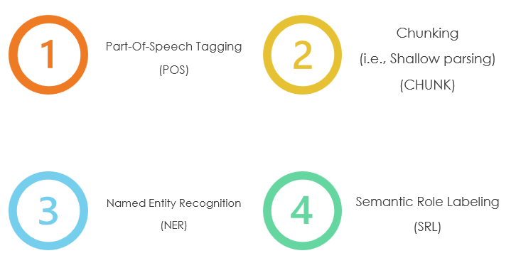
Benchmark system
Notes:
So benchmarks are always related to tasks. As we have talked before, our model should be capable of handling multiple tasks, so naturally we hope to test this feature through our benchmark system. That being said, we mainly identify four traditional NLP tasks, namely Part-Of-Speech Tagging, Chunking, Named Entity Recognition, and Semantic Role Labeling.

Slide 6
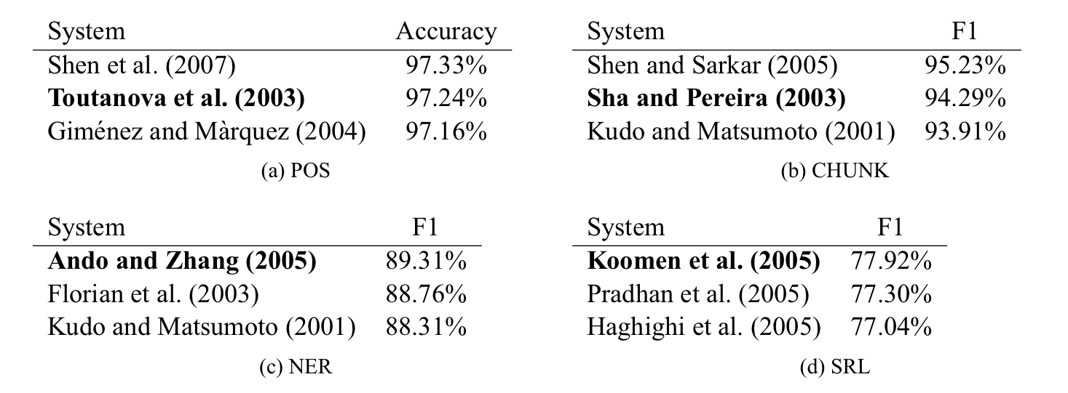
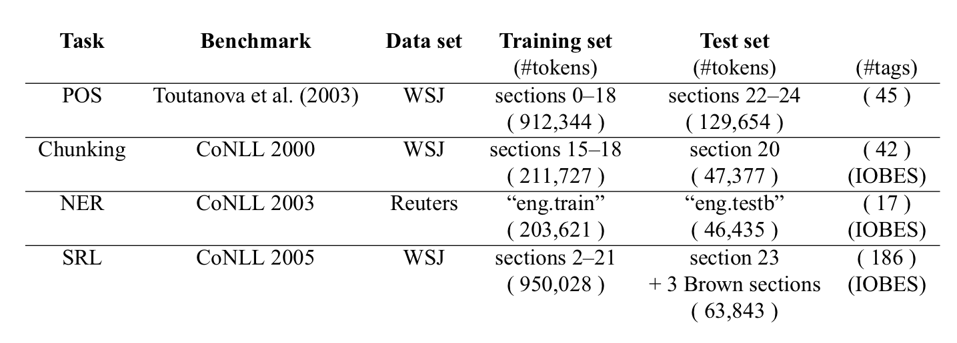
Benchmark system
Tasks
Benchmarks
Notes:
Then for each task, we choose an ideal benchmark to use and compare, according to its accuracy, precision, F1 score, and many other factors and parameters. Thereby we build our benchmark system, and it’s time to move on to the truly critical part – networks.

Slide 7






Notations
Network function:
Word matrix:
Word vector:
Given a matrix A we denote the coefficient at row i and column j in the matrix.
We also denote the vector obtained by concatenating the column vectors around the column vector of matrix :
Notes:
So here, let’s first employ some basic notations to simplify our discussion. We consider a neural network f θ (·), with θ δενοτινγ α χολλεχτιον οφ αλλ τηε παραμετερσ. Any feed-forward neural network with L layers, can be seen as a composition of functions f l θ (·), corresponding to each layer l, so we have the network function as shown above. And similarly, we denote the word matrix and word vector.

Slide 8
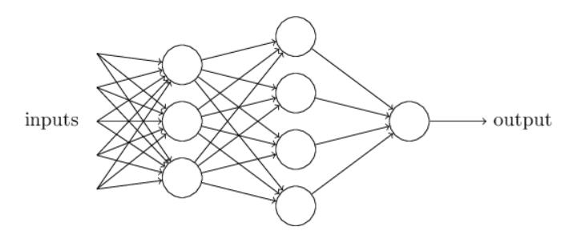
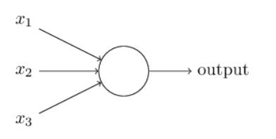
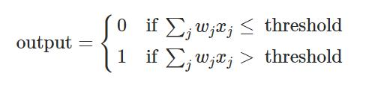
Networks
Single-layer neural networks
Multi-layer neural networks
Notes:
With those notations, let’s come to the architecture of the networks. You might remember that we have talked about how we employ multi-layer neural networks, and basically, a multi-layer neural network is no more than a single-layer neural network with more than one hidden layers. In other words, every output from the last layer is fed forward into the next layer as input.

Slide 9
Networks
Input layer
Hidden layers
Output layer
For efficiency, words are fed to our architecture as indices taken from a finite dictionary D.
Then we map each of these word indices into a feature vector by a lookup table operation.
This is one way to improve our algorithm.
We have basically two great models for hidden layers: window approach network, and sentence approach network.
At the end of the day, we choose the sentence approach network for reasons to discuss later.
We are using an end-to-end fashion.
As our model process more and more data, it becomes more and more sophisticated as our dataset becomes bigger and bigger.
In fact, this is related to the second way to improve our algorithm.
Notes:
Accordingly, let’s work through the network architecture. Remember that one of our key points is the networks’ ability to perform well with raw words. The ability for our method to learn good word representations is thus crucial to our approach. For efficiency, words are fed to our architecture as indices taken from a finite dictionary D. Obviously, a simple index does not carry much useful information about the word, so we map each of these word indices into a feature vector by a lookup table operation. Given a task of interest, a relevant representation of each word is then given by the corresponding lookup table feature vector, which is trained by backpropagation starting from a random initialization. And furthermore, it can be easily observed that if we wish to take advantage of better trained word representations, we can simply initialize our word lookup table with these representations instead of randomly. So this is a chance to further improve our algorithm, and we will talk more about that.
As for the output layer, one thing worthy to notice is that we are using an end-to-end fashion. We are feeding our output data back into the input and make our dataset bigger and bigger as we train it with more and more data. This is actually related to the second way to improve our algorithm, and also, we will talk more about that.

Slide 10
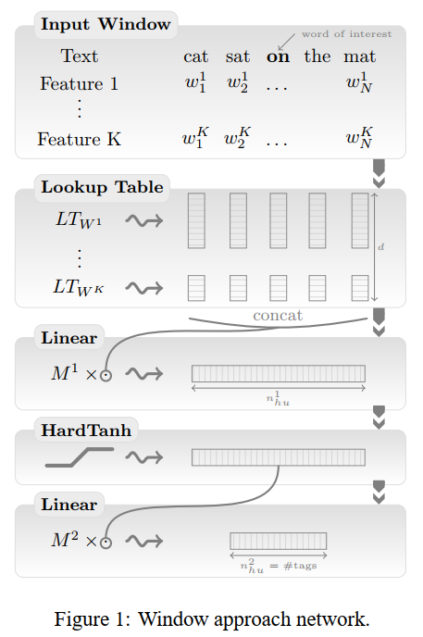
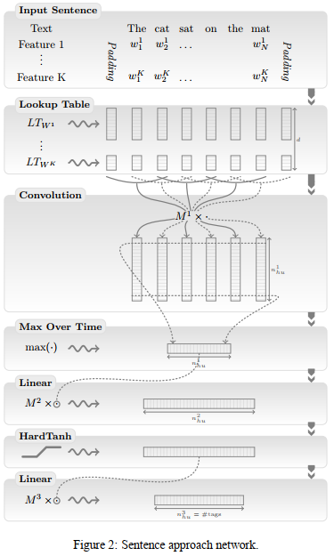
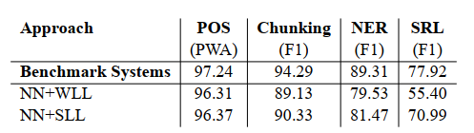
Hidden layers
Notes:
Having discussed the input and output layers, let’s finally focus on the hidden layers. As shown before, basically we have two options: window approach and sentence approach. A window approach assumes the tag of a word depends mainly on its neighboring words, which performs well for most NLP tasks we are interested in but fails with SRL, where the tag of a word depends on a verb chosen beforehand in the sentence. If the verb falls outside the window, one cannot expect this word to be tagged correctly. In this particular case, tagging a word requires the consideration of the whole sentence, where the sentence approach shows its strength.

Slide 11
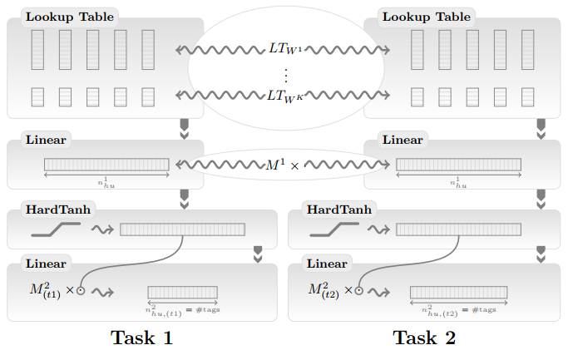
Multi-task Neural Networks
Notes:
Finally, after implementing neural networks for all our tasks, we continue to link them with one another so that our unified model can handle multiple tasks.

Slide 12
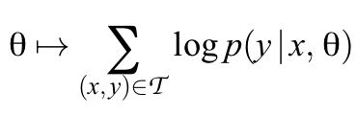
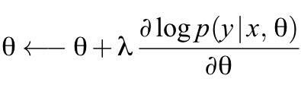
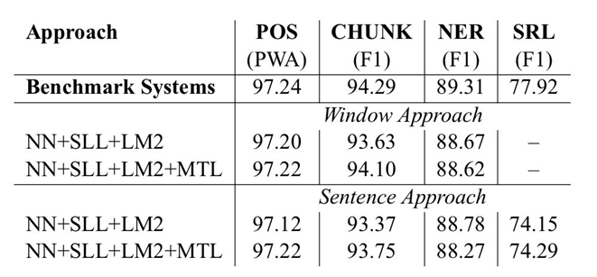
Examination of performance
Log-likelihood
Stochastic gradient ascent
Further improvement?
By incorporating some linguistic knowledge
By using more input to train our model
Notes:
In a word, we calculate the sentence-level log-likelihood from the word-level one, and all our neural networks are trained by maximizing this likelihood over the training data using stochastic gradient ascent. After training our model over natural language texts on Wikipedia for two months, favorable performance is observed. However, the statistical improvement of our unified model so far is marginal, but as we have mentioned before, we have two ways to further improve that: by incorporating some linguistic knowledge into our model, or by simply using more input.

Slide 13
Timeline and progress
Week 1
Week 2
Week 3
Prof. Lei Li comes as guest lecturer
Do research and decide on the main topic for this quarter’s 1L project
Find the specific concentration of NLP with DL
Do research on this area
Week 4
Study specific sources and work on NLP principles
Write code to implement the ideas
Week 5
Finish the NLP part
Second presentation
Week 6
Study ML principles
Week 7
Study the DL part in this project
Third presentation
Week 8
Finish the DL part
Construct the git repo
Week 9
Finish the construction of the git repo
Finish the study of Python courses
Continue the study of video courses and books on NLP
Week 10
Fourth (final) presentation
Plan for W23 1L
Find the possible concentration of Mandarin NLP
Do research on this area
First presentation
Finish the coding part
Notes:
To sum up, here is a timeline recording my progress for every week in this quarter’s 1L class. There are in total three main goals of this quarter’s work.

Slide 14
Takeaways and possible next steps
Goal 1
Goal 2
By mid-term, finish the study of the NLP part in this project
By final, finish the study of the DL part related to NLP in this project
Goal 3
By the start of next quarter, finish the study of the DL part that is not necessarily related to NLP
Notes:
Respectively related to the NLP part, the DL part related to NLP and more general DL knowledge. I have learned all those knowledge through not only courses and textbooks but also codes and implementations. For the 1L class in the next quarter, a possible concentration might be related to the input layer of NLP, or in other words, the energy efficiency of data storage and access. However, this has yet to be a definite choice. There is also plenty of possibilities for me to delve into any other interesting topics in NLP, DL, CV, or even broader areas.

Slide 15
Reference
Dr. Dan Jurafsky and Dr. James H. Martin, Speech and Language Processing (3rd ed. draft), NLP Research Group, Stanford University.
Agenda and proceedings, 11th CCF International Conference on Natural Language Processing and Chinese Computing (NLPCC2022).
Dr. Ronan Collobert, "Natural Language Processing (almost) from Scratch", Journal of machine learning research: JMLR. 12. ARTICLE (2011): n. pag. Print.
Dr. Michael A. Nielsen, "Neural Networks and Deep Learning", Determination Press, 2015.
CS224N: NLP with Deep Learning, Prof. Christopher Manning, Department of Linguistics and Computer Science, Winter 2021.
CS9: Immediate Python, Prof. Richert Wang, Department of Computer Science and CCS Computing, Winter 2021.
Dr. Ronan Collobert, "Deep Learning for Efficient Discriminative Parsing", International Conference on Artificial Intelligence and Statistics (AISTATS), 2011.
Note: There is still plenty of other valuable literature that has benefited the author greatly but is not tightly related to this repo. Therefore, the author does not include them in the "Main reference" part here, but will certainly give credit to them in later works or a personal repo. In other words, the reference above includes only materials that have directly helped the author during this project, and will also help you understand elements in this repo better.
Notes:
Finally, let’s conclude with some main reference that has helped me a lot, especially Number 3 “NLP from Scratch” by Dr. Ronan Collobert, which is the basis of my work this quarter. Also some acknowledgment…

Slide 16
Acknowledgment
This project is supported by the UCSB CMPTGCS 1L class in Fall 2022, advised by Prof. Phill Conrad at UCSB CCS. The overall direction of this project, the recommended NLP textbook, and many practical skills are all thanks to his precious guidance. Also, the author wants to thank Prof. Lei Li at UCSB CoE CS for professionally introducing many NLP resources and cutting-edge views, paving the road for the author to develop his specific project ideas. Finally, the author would like to thank Prof. Tim Sherwood from UCSB CoE, Prof. Richert Wang from UCSB CCS, Laya Pullela from UCSB CCS, and other anonymous supporters for their kind support for this project and beyond.
Notes:
(some acknowledgment) … for help and support towards this project, which includes Prof. Phill Conrad who advises my whole project and helps me a lot; and Prof. Lei Li, who helped me gain a lot of valuable professional knowledge in NLP, which eventually led to the specific direction of this project. Also, I’d like to thank Prof. Tim Sherwood, Prof. Richert Wang, and many other guest lecturers and researchers that have helped me a lot. Finally, I want to mention my peers in the 1L class and our enlightening discussions in and out of class. As that brings us to the end, I’d like to thank everyone for your presence and attention today.

Slide 17
Thank you
PEIYANG SONG (he/him/his)
CCS Computing ‘26
p_song@ucsb.edu
NLP DL
CMPTGCS 1L Fall 2022
Instructor: Prof. Phill Conrad
Notes:
I sincerely appreciate that I’ve had this opportunity to present to you all. And hopefully…

Slide 18
Thank you… and Q & A section!
PEIYANG SONG (he/him/his)
CCS Computing ‘26
p_song@ucsb.edu
NLP DL
CMPTGCS 1L Fall 2022
Instructor: Prof. Phill Conrad
Notes:
(And hopefully)… we still have some time left for questions and discussions.

